Slide 1



SMART IRRIGATION LEAKAGE DETECTION
Guided By
Dr.B.Neeththi Aadithiya
Presented By
KANIHA S (927623BEC100)
KAVIYA P (927623BEC110)
KIRUNISHA M (927623BEC113)

Slide 2
Introduction
The system uses dual flow sensors to continuously monitor water flow in irrigation pipelines; any sudden drop or zero reading at the second sensor indicates a leakage condition.
The Arduino microcontroller processes the flow data and sends instant leakage alerts through a Wi-Fi module (ESP8266) to the Blynk IoT app and linked email.
This IoT-enabled smart irrigation system promotes efficient water usage, minimizes wastage, and enables automated, sustainable agriculture with real-time monitoring.

Slide 3
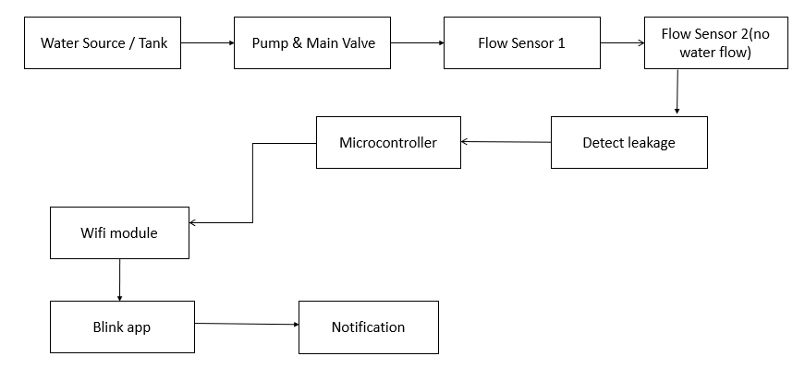
Block Diagram/Circuit Diagram

Slide 4
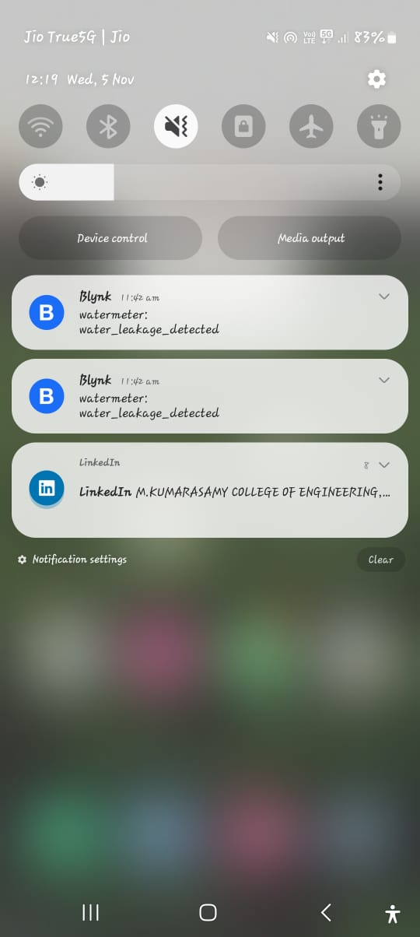
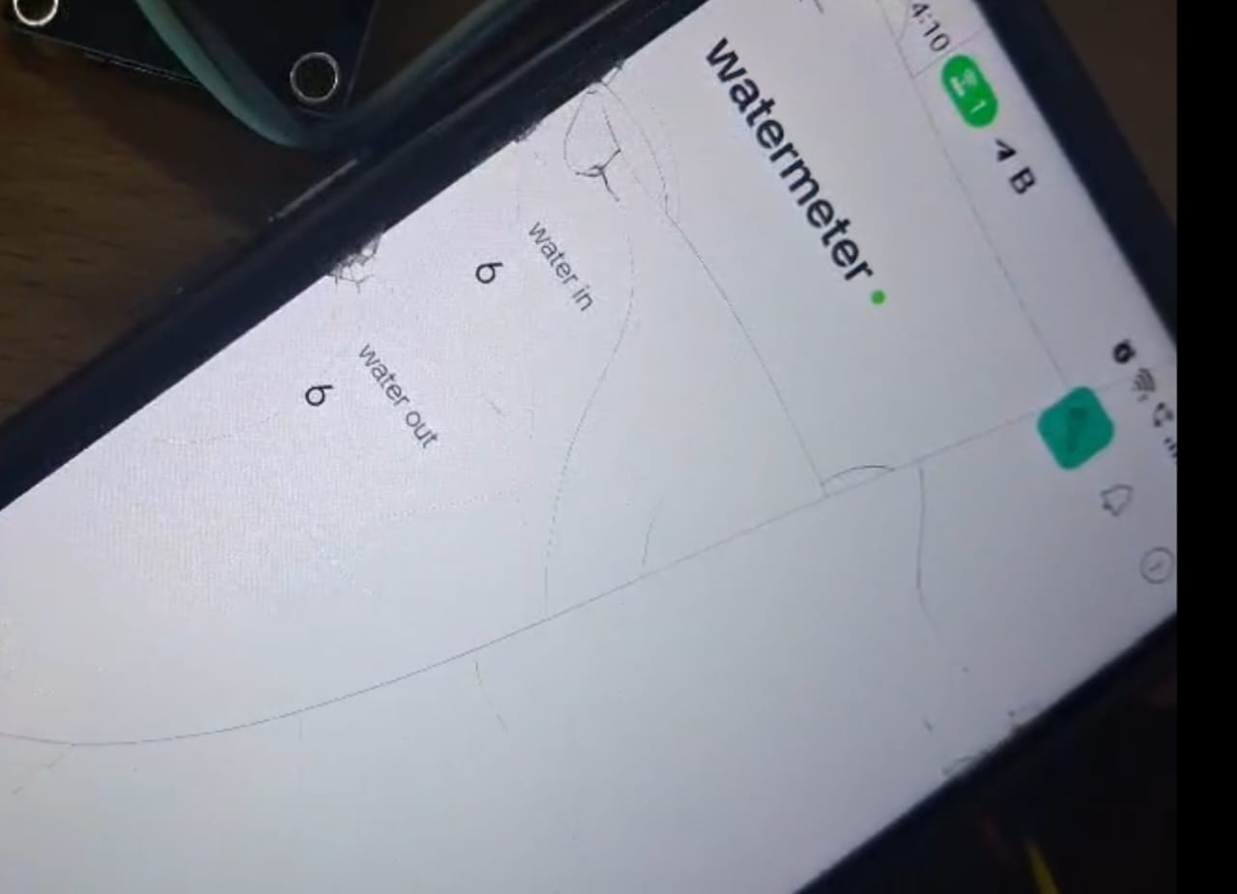
Simulation Results
Water Leakage Detected
Water Rate

Slide 5
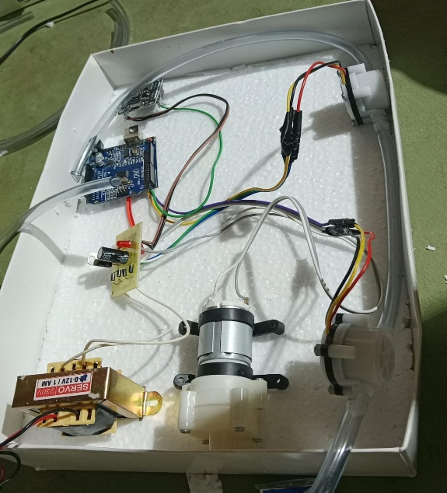
Hardware Design
Hardware Design Kit

Slide 6
Project Outcome
The project will be published in the IEEE platform and a project report will be prepared.

Slide 7
Conclusion
The Smart Irrigation Leakage Detection System provides an effective solution to overcome the drawbacks of traditional irrigation methods.
By using Arduino, flow sensors, and IoT technology, this system can detect water leakages in real time and immediately alert the user through the Blynk App.
This project not only saves water and electricity but also reduces manual monitoring efforts for farmers.
The system promotes efficient water management and supports sustainable farming practices by ensuring that water is used wisely and only when needed.

Slide 8
Reference
M. Priya, K. Senthil, “Automatic Irrigation and Leakage Detection System using IoT,” International Journal of Innovative Research in Science, Engineering and Technology (IJIRSET), Vol. 11, Issue 2, 2024.
N. Gupta, P. Sharma, “Smart Agriculture System using Arduino and IoT,” IEEE Conference on Smart Technologies for Smart Nation, 2022.
TutorialsPoint, “Interfacing Water Flow Sensor with Arduino,” Available at: https://www.tutorialspoint.com
Sensor-Driven Smart Irrigation System for Water ManagementAzdizul Fahman Azman; Siti Aishah Che Kar; Nur Idawati Md Enzai; Rosmawati Shafie(2025).

